Slide 1
Chapter 10 Work and Wealth

Slide 2
Chapter Overview
Introduction
Automation and unemployment
Workplace changes
Globalization
The digital divide
The “winner-take-all society”

Slide 3
10.1 Introduction
Information technology and automation affecting workplace
Increases in productivity
Globalization of job market
Organization of companies
Telework
Workplace monitoring
Impacts of information technology on society
Digital divide
Winner-take-all effects

Slide 4
10.2 Automation and Unemployment

Slide 5
Automation and Job Destruction
Between 1979 and 2008…
U.S. population increased 35%
Manufacturing employment dropped 31%, from 19.4 million jobs to 13.5 million jobs
Lost white-collar jobs
Secretarial and clerical positions
Accountants and bookkeepers
Middle managers
Juliet Schor: Work week got longer between 1979 and 1990

Slide 6
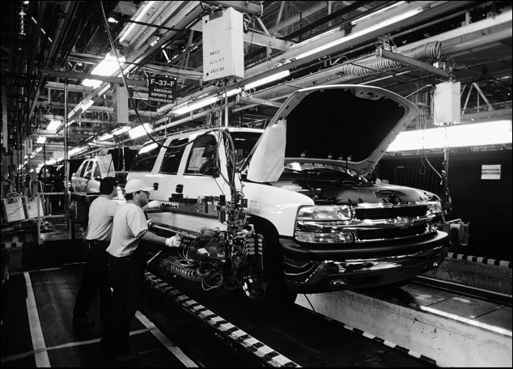
General Motors Exited Bankruptcy in 2009 with 30% Fewer Employees
Danny Lenman / Corbis

Slide 7
Layoffs May Increase Stress on Remaining White-Collar Workers

Slide 8
Automation and Job Creation
Automation lowers prices
That increases demand for product
It also increases real incomes
Increasing demand for other products
Increased demand → more jobs
Number of manufacturing jobs worldwide is increasing
Martin Carnoy: Workers today work less than workers 100 years ago
Example of job creation (P. 452)

Slide 9
Automation Can Create Jobs, Too

Slide 10
Effects of Increase in Productivity
We have used higher productivity to achieve a higher material standard of living
This is in contrast to medieval or ancient times (before modern capitalism)
In medieval or ancient times
Low caloric intake meant pace of work was slow
Work was seasonal and intermittent
Laborers resisted working if they had enough money
When wages rose, laborers worked less

Slide 11
Rise of the Robots?
Some experts suggest most jobs will be taken over by machines
Artificial intelligence: Field of computer science focusing on intelligent behavior by machines
Rapid increases in microprocessor speeds have led to various successes in AI
What will happen as computers continue to increase in speed?

Slide 12
Notable Achievements in AI since 1995
Computer-controlled minivan “drove” on freeways across USA in 1995
IBM supercomputer Deep Blue defeated chess champion Gary Kasparov in 1997
Honda’s ASIMO android can climb and descend stairs and respond to human gestures and postures
Electrolux introduced robotic vacuum cleaner in 2001
Five autonomous vehicles successfully completed 128-mile course in Nevada desert in 2005
Watson trounced two most successful human Jeopardy! champions in 2011

Slide 13
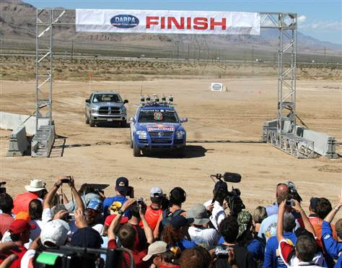
Stanley, the Autonomous Vehicle
© Gene Blevins/Reuters/Corbis
The Stanford Racing Team converted a Volkswagen Touareg into an autonomous vehicle named Stanley that successfully followed a 128-mile through the Nevada desert in 2005

Slide 14
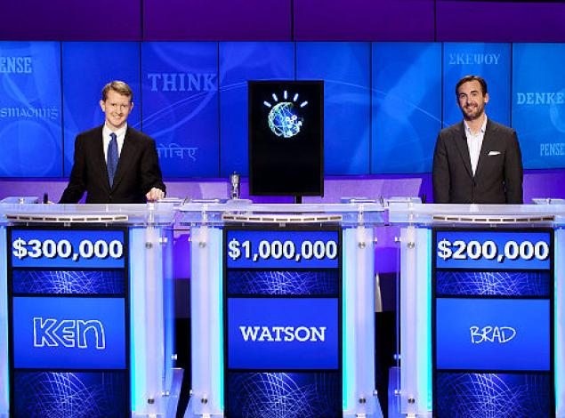
Watson Wins Jeopardy! Challenge

Slide 15
Moral Question Related to Robotics
Is it wrong to create machines capable of making human labor obsolete?
Would intelligent robots demoralize humanity?
Is it wrong to work on an intelligent machine if it can’t be guaranteed the machine will be benevolent toward humans?
What if a malevolent human puts intelligent machines to an evil use?
How would creative computers change our ideas about intellectual property?

Slide 16
10.3 Workplace Changes

Slide 17
Organizational Changes
Information technology integration into firms
Automating back office functions (e.g., payroll)
Improving manufacturing
Improving communication among business units
Results
Flattened organizational structures
Eliminating transactional middlemen (supply-chain automation)

Slide 18
Inexpensive Interactions Lead to Flexible Information Flow
(a)
(b)
When interactions are more expensive and time-consuming, most information flows between people and their managers. Organizations are rigid and hierarchical.
When interactions become inexpensive and fast, the flow of information is much more flexible. Organizations become flatter and more dynamic.

Slide 19
Winners, Losers in the Workplace of the Future
Higher Demand | Lower Demand
Computer engineers | Bank clerks
Computer support specialists | Procurement specialists
System analysts | Financial records processing staff
Database administrators | Secretaries, stenographers, and typists
Desktop publishing specialists | Communications equipment operators
 | Computer operators

Slide 20
Telework
Employees work away from traditional place of work
Examples
Home office
Commuting to a telecenter
Salespersons with no office
About 20% of Americans do some telework

Slide 21
Advantages of Telework
Increases productivity
Reduces absenteeism
Improves morale
Helps recruitment and retention of top employees
Saves overhead
Improves company resilience
Helps environment
Saves employees money

Slide 22
Disadvantages of Telework
Threatens managers’ control and authority
Makes face-to-face meetings impossible
Sensitive information less secure
Team meetings more difficult
Teleworkers less visible
Teleworkers “out of the loop”
Isolation of teleworkers
Teleworkers work longer hours for same pay

Slide 23
Temporary Work
Companies less committed to employees
Lay-offs not taboo as they once were
Companies hiring more temporary employees
Saves money on benefits
Makes it easier to downsize
Long-term employment for one firm less common

Slide 24
Monitoring
82% of companies monitor employees in some way
Purpose: Identify inappropriate use of company resources
Can also detect illegal activities
Other uses of monitoring
Gauge productivity (10% of firms)
Improve productivity
Improve security

Slide 25
Multinational Teams
Software development teams in India since 1980s
Advantages of multinational teams
Company has people on duty more hours per day
Cost savings
Disadvantage of multinational teams
Poorer infrastructure in less developed countries

Slide 26
10.4 Globalization

Slide 27
Globalization Basics
Globalization: Process of creating a worldwide network of businesses and markets
Globalization causes a greater mobility of goods, services, and capital around the world
Globalization made possible through rapidly decreasing cost of information technology

Slide 28
Declines in Computing & Communication Costs Spurred Globalization

Slide 29
Arguments for Globalization
Increases competition
People in poorer countries deserve jobs, too
It is a tried-and-true route for a poor country to become prosperous
Global jobs reduce unrest and increase stability

Slide 30
Arguments against Globalization
Makes the United States subordinate to the World Trade Organization
Forces American workers to compete with foreigners who do not get decent wages and benefits
Accelerates exodus of manufacturing and white-collar jobs from United States
Hurts workers in foreign countries

Slide 31
Dot-Com Bust Increases IT Sector Unemployment
Dot-com: Internet-related start-up company
Early 2000: stock prices of dot-coms fell sharply
Hundreds of dot-coms went out of business
Half a million high-tech jobs lost

Slide 32
Foreign Workers in the IT Industry
Visas allow foreigners to work inside U.S.
H1-B
Right to work up in United States to six years
Company must show no qualified Americans available
Congress still authorizes 65,000 H1-B visas per year, plus 20,000 more for foreigners with advanced degrees
Quota not filled in 2009 due to economic downturn
L-1
Allows a company to transfer a worker from an overseas facility to the United States
Workers do not need to be paid the prevailing wage
In 2006 about 50,000 foreigners in U.S. under L-1 visa

Slide 33
Foreign Competition
China is world’s number one producer of computer hardware
IT outsourcing to India is growing rapidly
Number of college students in China increasing rapidly
ACM Collegiate Programming Contest provides evidence of global competition (P. 468)

Slide 34
Growth of China’s Computer-Hardware Industry

Slide 35
10.5 The Digital Divide

Slide 36
Concept of the Digital Divide
Digital divide: Some people have access to modern information technology while others do not
Underlying assumption: people with access to telephones, computers, Internet have opportunities denied to those without access
Concept of digital divide became popular with emergence of World Wide Web

Slide 37
Evidence of the Digital Divide
Global divide
Access higher in wealthy countries
Access higher where IT infrastructure good
Access higher where literacy higher
Access higher in English-speaking countries
Access higher where it is culturally valued
Social divide
Access higher for young people
Access higher for well-educated people

Slide 38
Percentage of People with Internet Access, by World Region
Internet penetration rates as of 2012 Q2 (cf. P. 469)

Slide 39
Models of Technological Diffusion
Technological diffusion: rate at which a new technology is assimilated
Group A: highest socioeconomic status
Group B: middle socioeconomic status
Group C: lowest socioeconomic status
Normalization model
Group A adopts first, then Group B, finally Group C
Eventually A use = B use = C use
Stratification model
Group A adopts first, then Group B, finally Group C
A use > B use > C use forever

Slide 40

Two Models for Technological Diffusion
100%
100%
A
A
B
B
Diffusion of technology
C
Diffusion of technology
C
Time
Time
(a) Normalization model
(b) Stratification model

Slide 41
Critiques of the Digital Divide
DD talk suggests the difference between “haves” and “have nots” is simply about access
DD talk puts everyone in two categories, but reality is a continuum
DD implies lack of access leads to less advantaged social position, but maybe it is the other way around
Internet is not the pinnacle of information technology

Slide 42
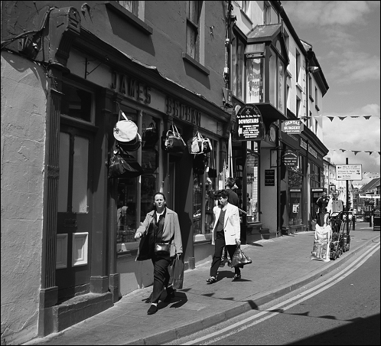
Street Scene in Ennis, Ireland
© Richard Cummins / CORBIS
Unemployed workers in Ennis, Ireland, resisted using the Internet to receive their benefits, preferring to report in person to the social welfare office, where they could visit with other people.

Slide 43
Net Neutrality
Tiered service: Charging more for high-priority routing of Internet packets
Supporters of tiered service say it is needed to support Voice-over-IP and other services
Opponents to tiered service (e.g., Google, Yahoo!) say it would hurt small start-up companies and lower innovation
Others think companies controlling Internet might favor some content over other content
Net neutrality legislation would require all Internet packets be treated the same
Opponents of proposed legislation say consumers should be able to pay more to get higher quality service

Slide 44
10.6 The “Winner-Take-All Society”

Slide 45
The Winner-Take-All Phenomenon
Winner-take-all: a few top performers have disproportionate share of wealth
Causes
IT and efficient transportation systems
Network economies
Dominance of English language
Changing business norms

Slide 46


CEO Pay v. Production Worker Pay, 1980 and 2003
CEO
CEO
≈ 400 times
≈ 40 times
Worker
Worker
1980
2003

Slide 47
Jim Furyk Earned 99 Times More Than Brian Bateman in 2009; Is He 99 Times Better?
Metric | Brian Bateman | Jim Furyk
Driving distance (yards) | 289.1 | 278.1
Driving accuracy (%) | 56.23 | 70.24
Greens in regulation (%) | 63.95 | 64.67
Putts / round | 29.42 | 28.17
Scoring average | 71.89 | 70.24
Tournaments entered | 21 | 21
Winnings | $35,379 | $3,514,215

Slide 48
Reducing Winner-Take-All Effects
Limit number of hours that stores remain open
Businesses form cooperative agreements to reduce positional arms races
Example: salary caps on pro sports teams
More progressive tax structures
Campaign finance reform

